Slide 1
Project Dashboard
File created on: 3/2/2022 6:45:55 PM

Slide 2
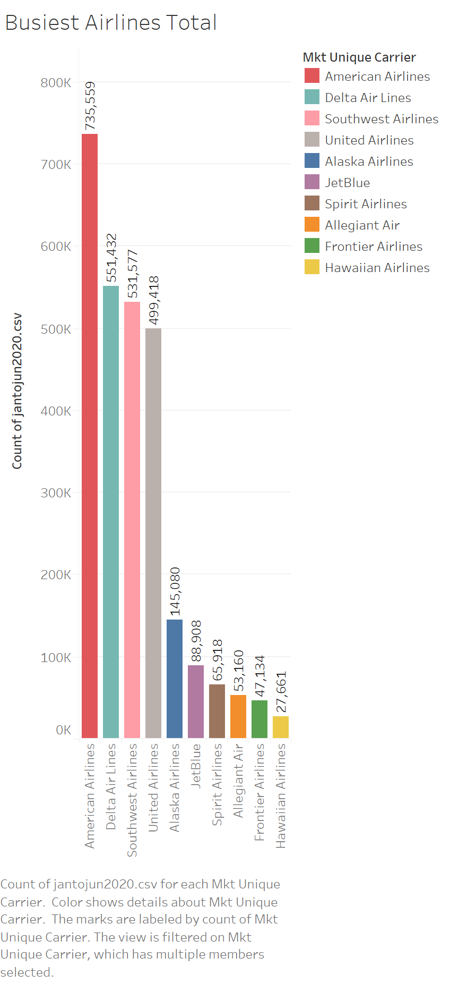

Slide 3
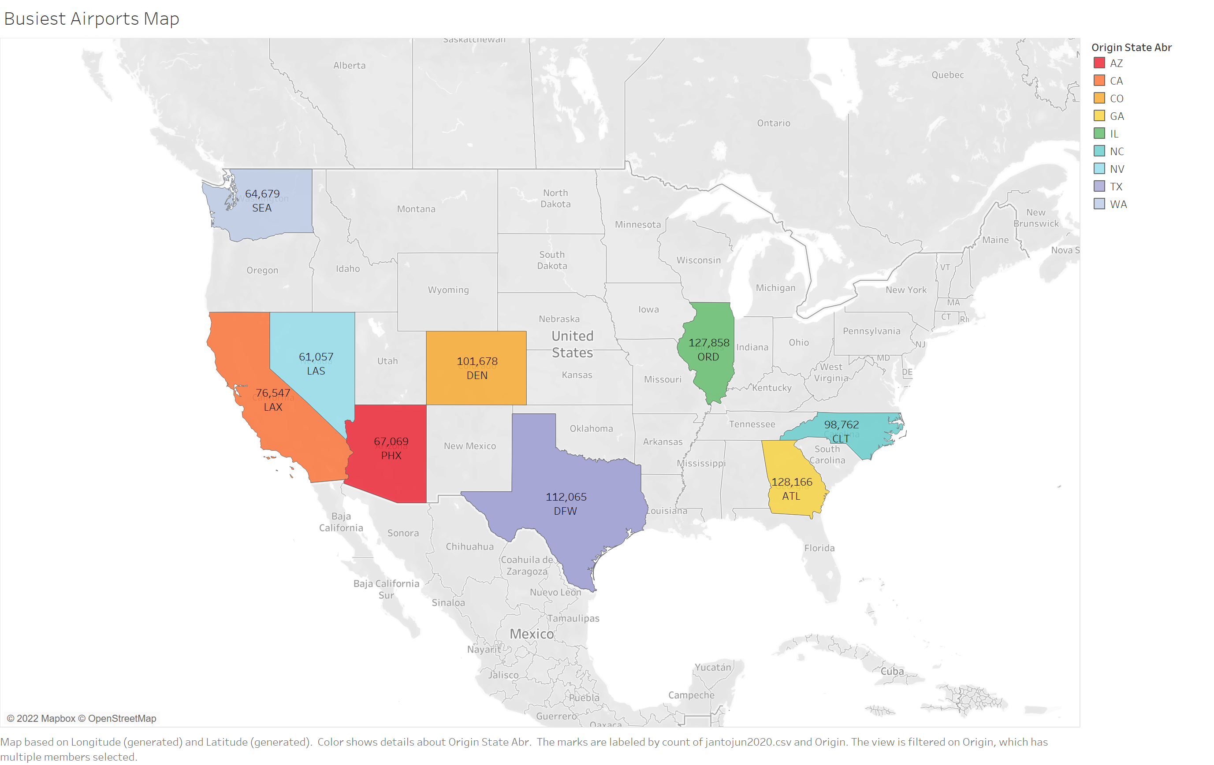

Slide 4
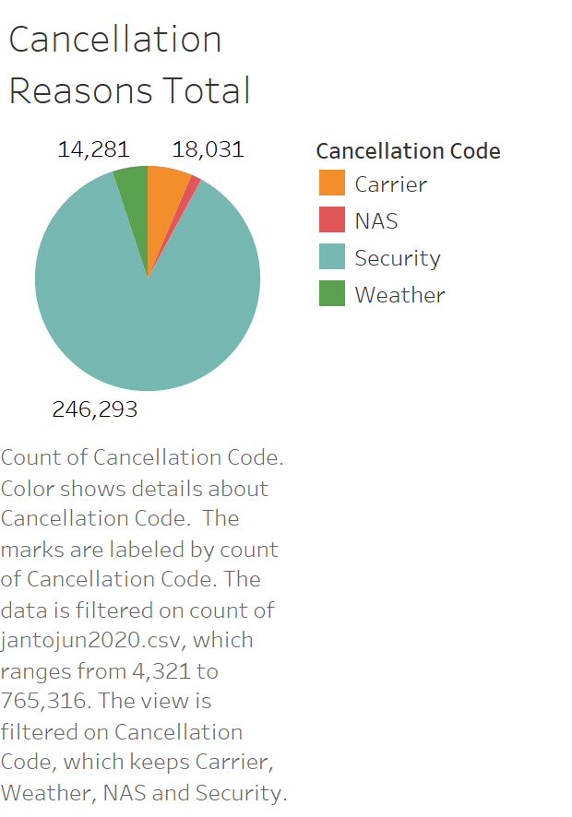

Slide 5
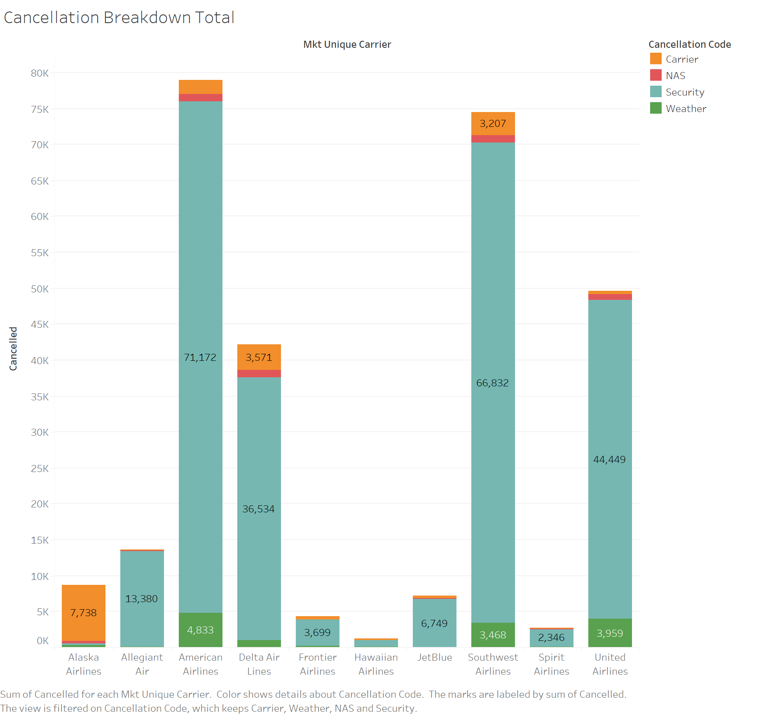

Slide 6
